Slide 1
Challenges in Academic Support: Insights into Existing Gaps
Needfinding Report

Slide 2


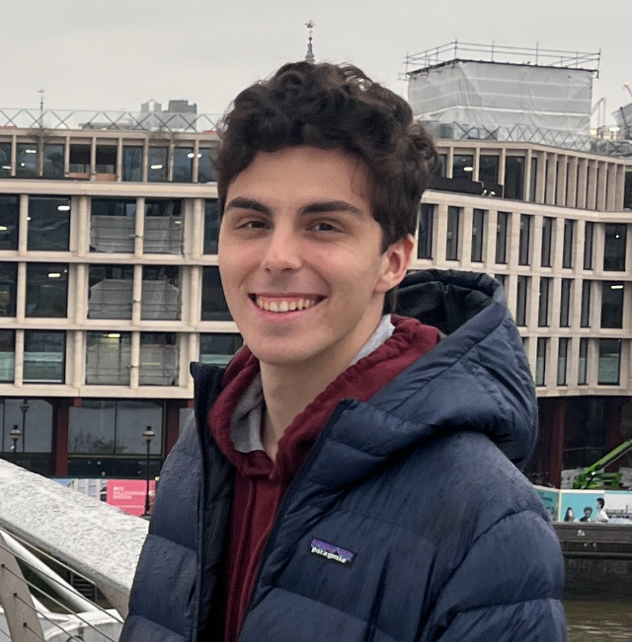
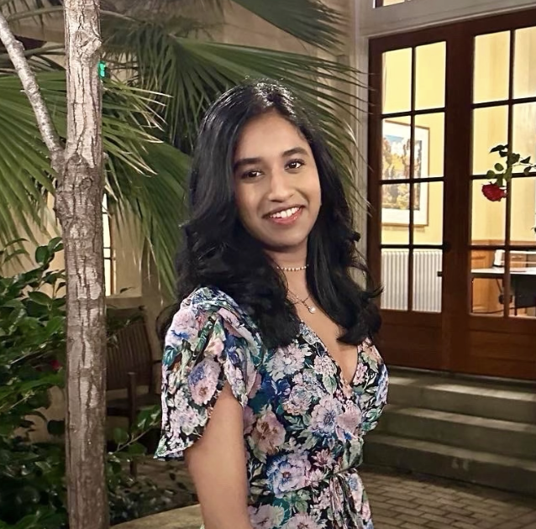

Meet the Team!
Jennifer Lew (’26) Computer Science (AI) Palos Verdes, CA
Alex Yansouni (’26) Computer Science (HCI) Los Altos, CA
Meghana Paturu (’26) Computer Science (HCI) & Economics Belle Mead, NJ
Jonah Blaydes-Greenberg (’26) Computer Science (HCI) & Music Los Altos, CA

Slide 3





Domain Selection
How can we make learning and getting help easier and more efficient + accessible ?
College-Focused Academic Support
What are the academic struggles we face?
How can students make money easily?

Slide 4
Guiding Questions
Guiding Questions
How well do the school’s support services align with your learning needs?
What challenges do you face when trying to get help from teaching assistants (TAs) or professors?
Instead of limiting AI usage in academic environments, how can AI be leveraged to enhance and empower learning?
How effective were online platforms provided by the school for getting academic help (e.g., discussion boards, virtual office hours)?
What and how is the process and effects of becoming a TA/Tutor?

Slide 5
Finding Participants
Range of Student Ages: High School, College, Master’s/TA
Within and Beyond the Stanford Community
Variety of Schooling Systems: Homeschool, Community College, State School, Private Schools
Diversity of Academic Backgrounds (Different Majors/Minors)

Slide 6




We talked to…
🕵️‍♂️
“Grace Hopper”
Community College Pre-Law
Junior
Los Angeles, CA
“Donald Knuth”
Private College Business Major Junior
Bay Area, CA
“Alan Turing”
Highschool Senior
Bay Area, CA
“Ada Lovelace”
Full Time TA + EdTech Researcher
Portland, OR
“Margaret Hamilton”
Pre-Med & Student-Athlete
Junior
Las Vegas, NV

Slide 7
“Ada Lovelace”
In-person interview at Coupa Cafe, Voice Memo
Female (23), Full-Time Teaching Assistant and EdTech/NLP Researcher
“Stanford’s TA system is I would say super intense, selective, and kind of a long process. It sucks how some of the most qualified people, like a few of my genius friends, get overlooked just because they don’t fit the tunnel vision of what is considered to be a good tutor. And for the most part, they just do not want to reapply or go through that lengthy process anymore.”

Slide 8


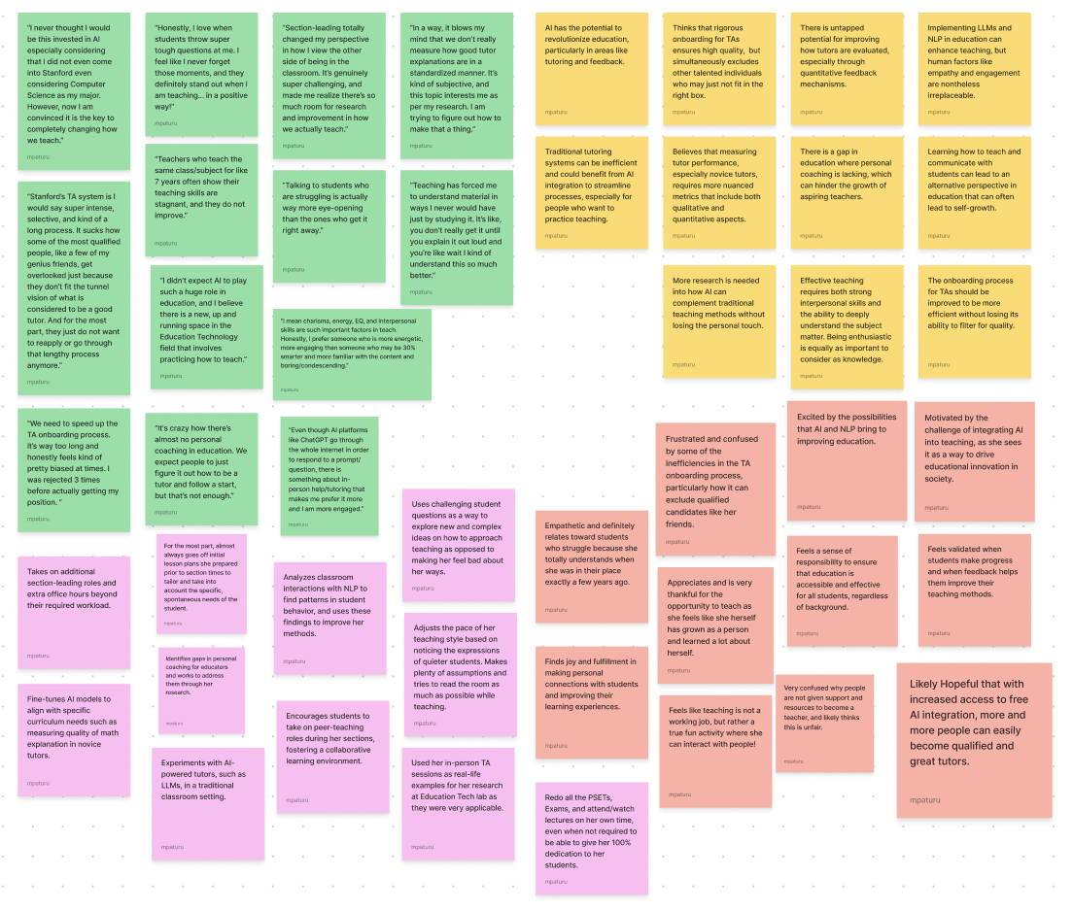
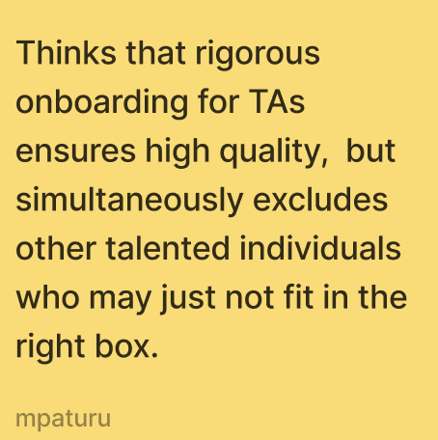

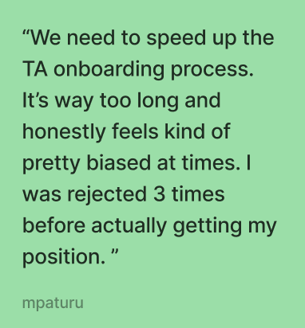
SAYS
THINKS
DOES
FEELS
Notes:
Main takeaway:

Slide 9
“Ada Lovelace”
Insights:
Though comprehensive and does a good job, the process to become a Teaching Assistant at Stanford is very long and lengthy - many interested tutors/TAs end up giving up.
Very few efficient resources for tutors to learn how to teach well and properly.
Needs:
Efficient system/unbiased way to hire tutors faster and quickly.
More accessible educational/evaluators platforms to teach tutors how to be good teachers (AI can potentially be a solution!)

Slide 10
“Margaret Hamilton”
In-person interview at coffee shop, Voice Memo
Female (21), Student-Athlete, Pre-Med, Human Biology Major (Home-Schooled prior to Northwestern)
“Sometimes finding help was too hard, or they did not have enough time/space to give me the help I needed especially with my rigid practice schedules. At one point, I remember giving up on an assignment and turned it in unfinished.”

Slide 11
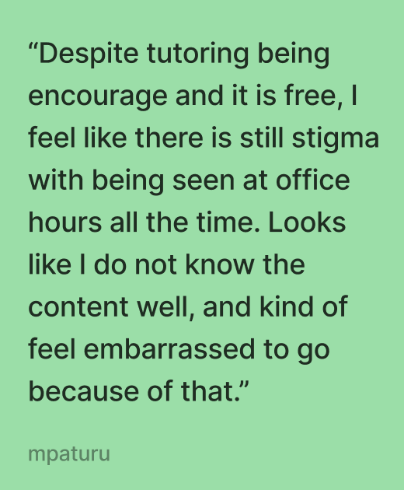
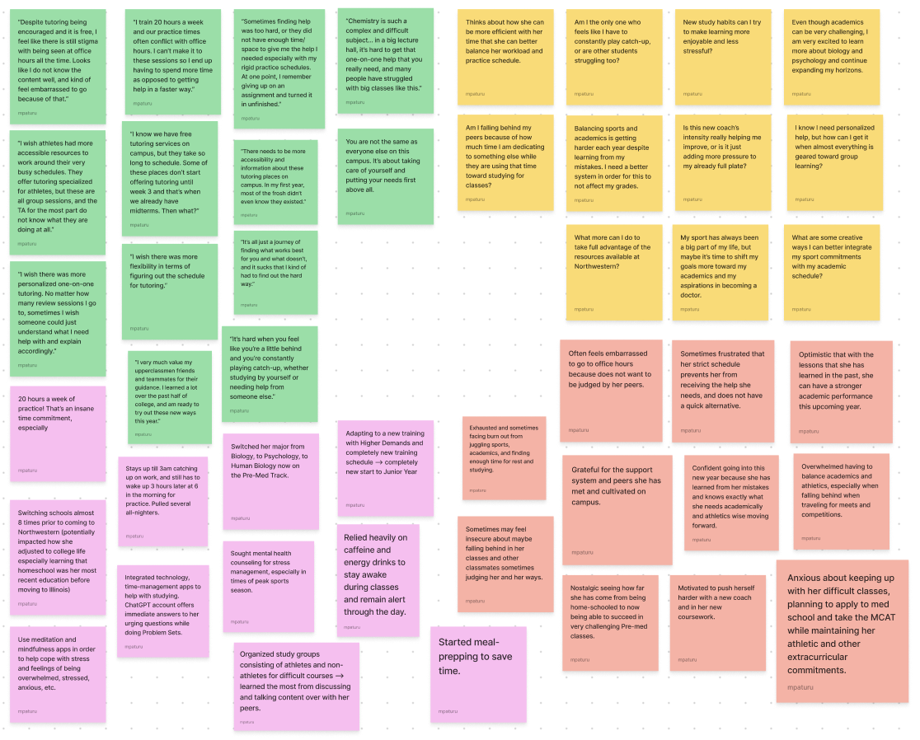
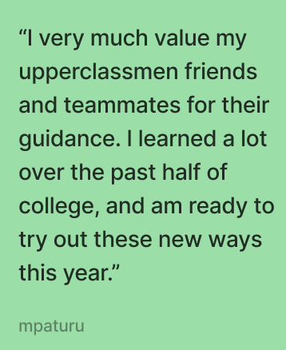
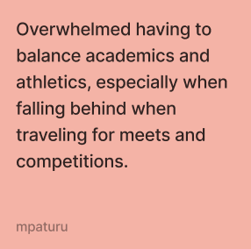
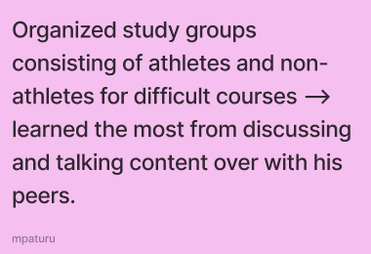
SAYS
THINKS
DOES
FEELS
Notes:
Main takeaway:

Slide 12
“Margaret Hamilton”
Insights:
Group tutoring and generalized support systems often don't meet his specific needs as a student-athlete → feelings of isolation in both academics and sports.
Rigid practice schedule prevents getting help → hopelessness
Needs:
More personalized academic support tailored to student-athletes, such as flexible one-on-one tutoring or mentoring programs that accommodate tight practice schedules.
Time-efficient, structured system to help him better integrate academic and athletic responsibilities.

Slide 13
“Grace Hopper”
Zoom interview
Female College Student, 20
Pre-law
Previously attended UCSC, community college, USC
“I’m concerned if the TAs can actually help me with my classes given how many students there are in each class.”

Slide 14
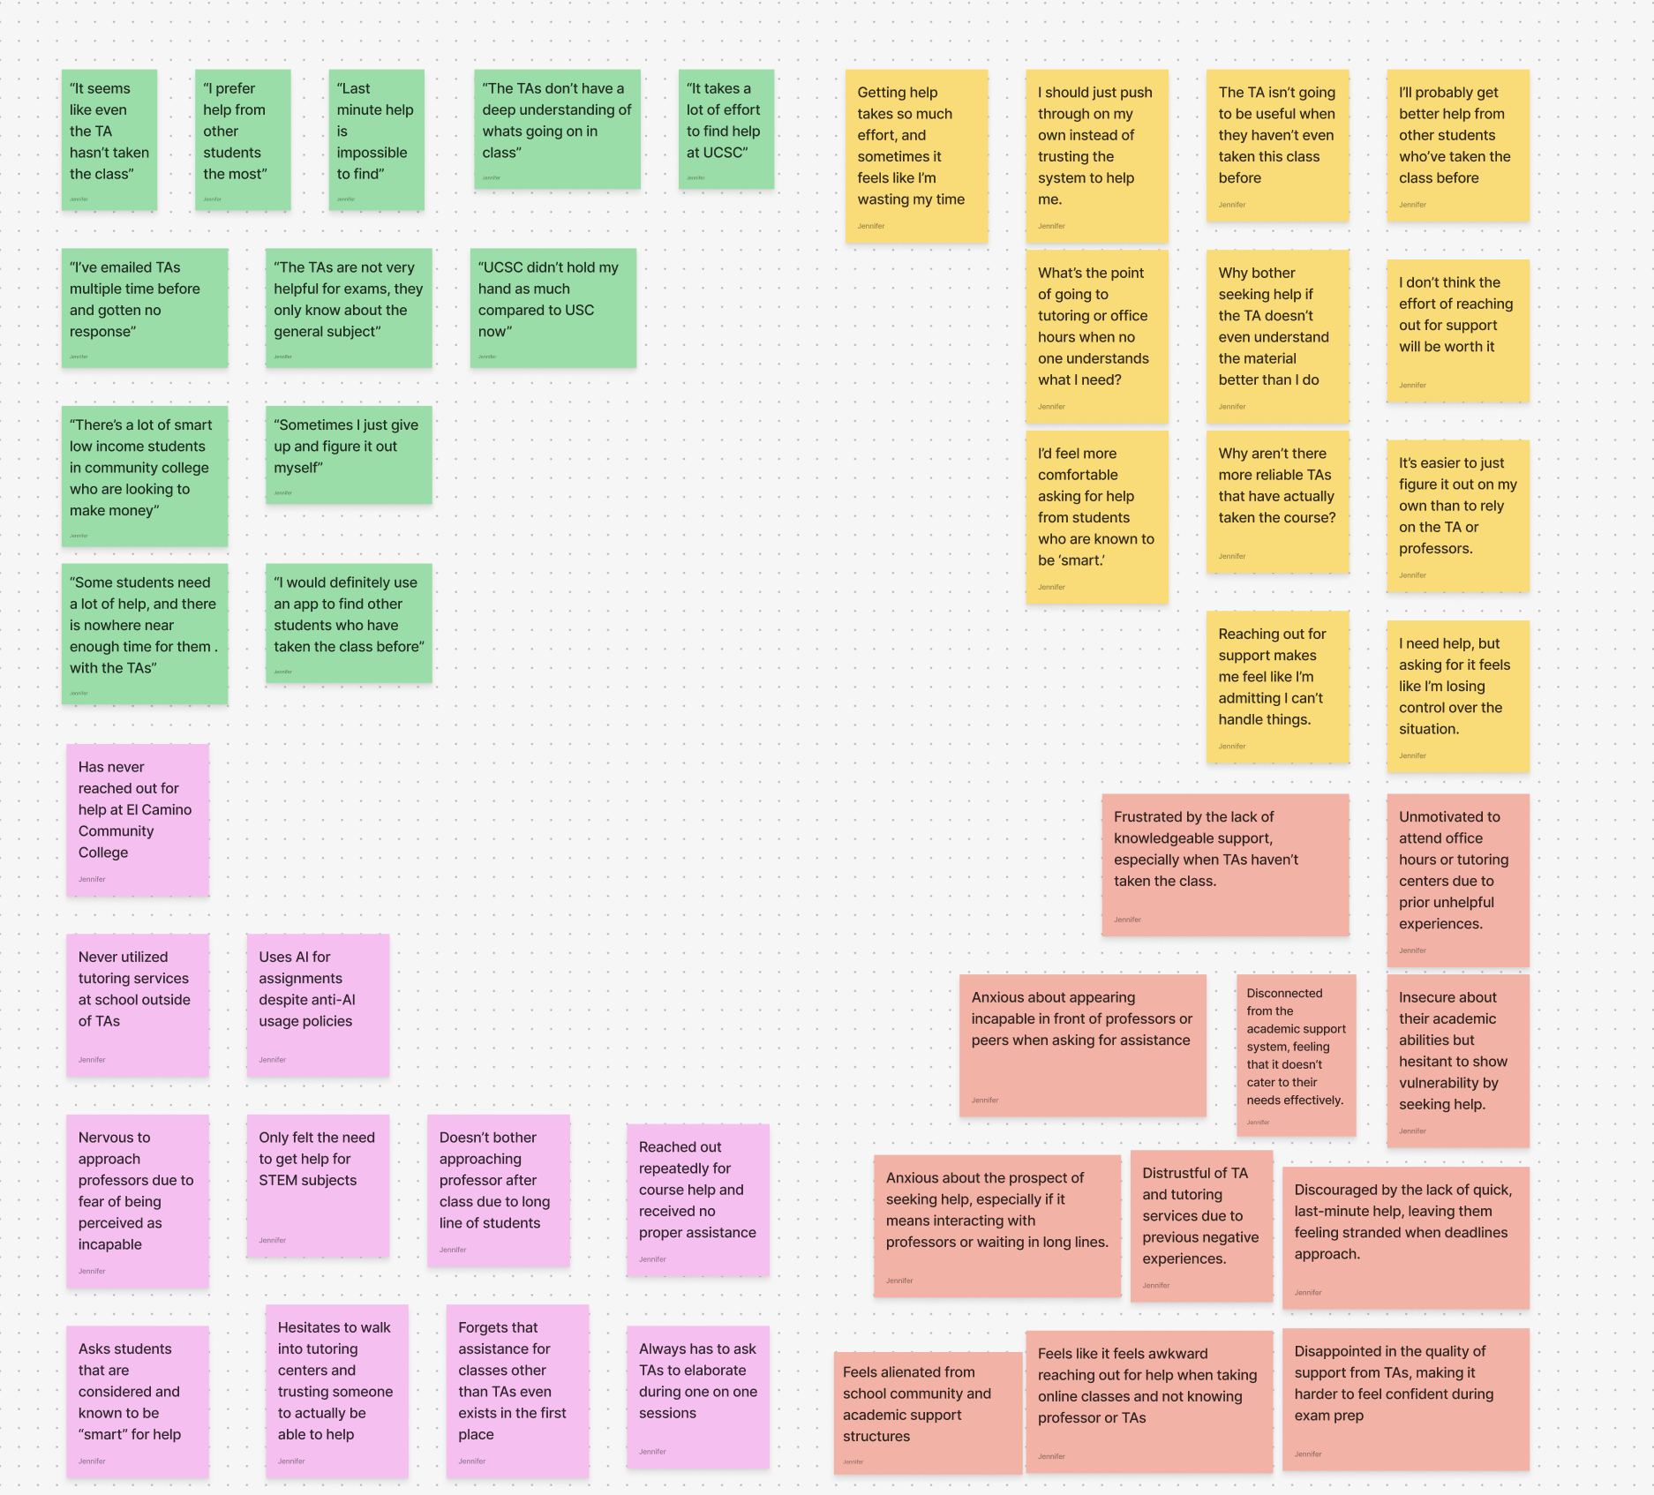

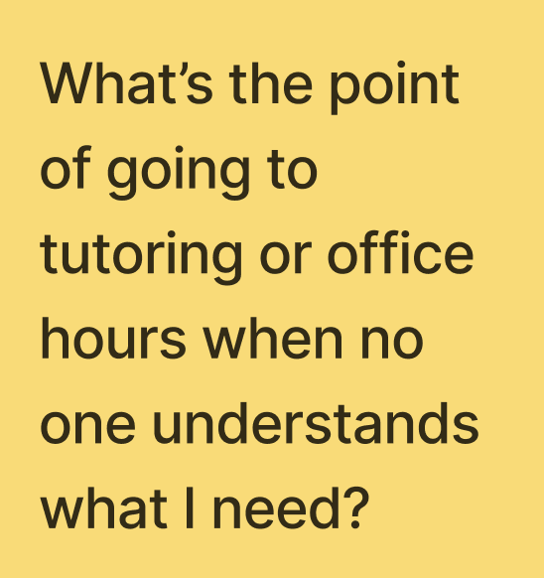
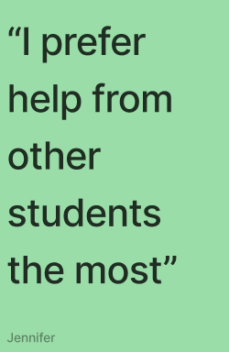
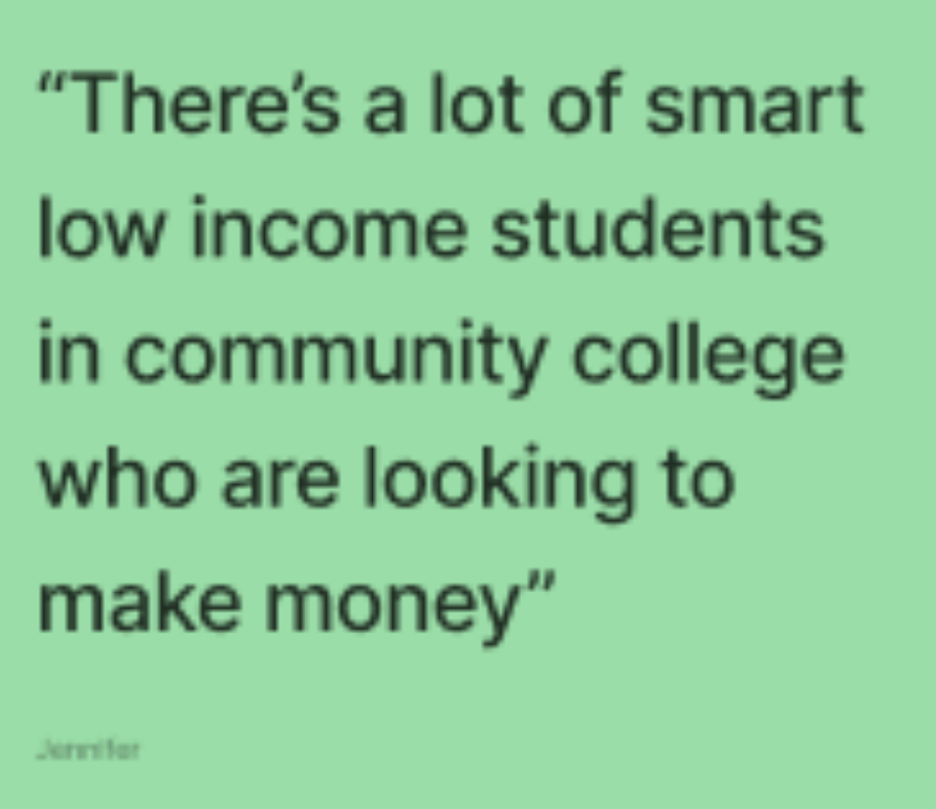
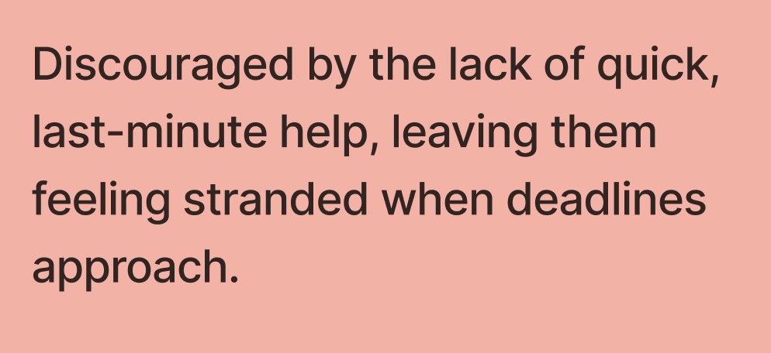
SAYS
THINKS
FEELS
DOES

Slide 15
“Grace Hopper”
Insights:
Unsatisfied with quality of TA’s and their qualifications to assist with course material
Hard to get longer one on one sessions given so many students at bigger schools/institutions.
Needs:
An way to easy access qualified individuals who are capable of helping students and understand course material
Faster, and more efficient way to be able to help more students in shorter periods of time.
Easier way to students to make money.

Slide 16
“Donald Knuth”
In Person Interview in Dorm, Voice Memo
Male, Junior (20) at Santa Clara University
Accounting Major
“I’m not really one to utilize them [academic support structures]. I just try to figure it out on my own.”

Slide 17
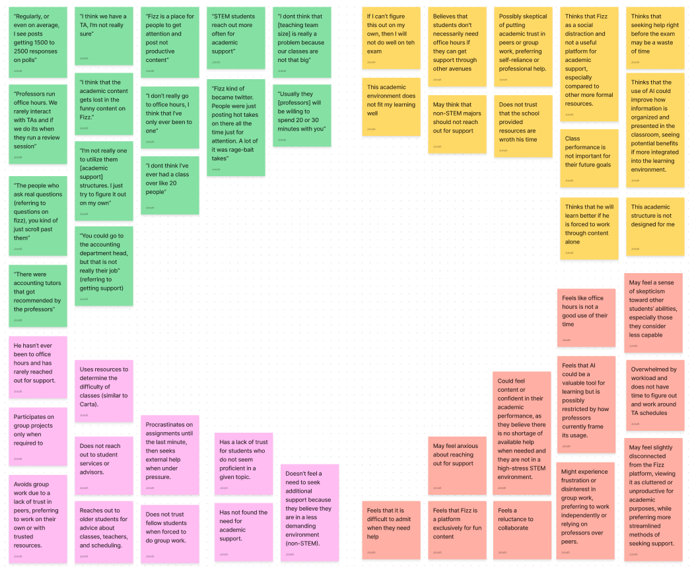
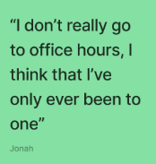
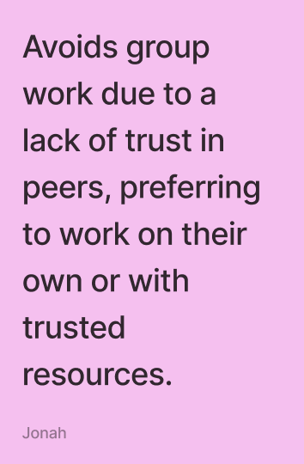
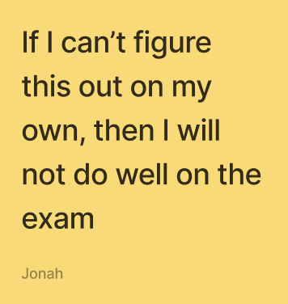
THINKS
SAYS
FEELS
DOES

Slide 18
“Donald Knuth”
Insights:
Does not reach out for academic support due to challenges using the existing systems.
Small classes without TAs means that it is difficult to receive learning aid.
Needs:
A streamlined way to receive educational assistance when the Professor is not available
Structured Advice from older students
Notes:
Only professor and Only TAs

Slide 19
“Alan Turing”
Zoom Interview
Male, Senior (18) at a local private high school
Aspiring International Policy major
“But I'd say with the presence of AI, I've seen a lot fewer kids go to office hours just as a general trend.”
🕵️‍♂️

Slide 20
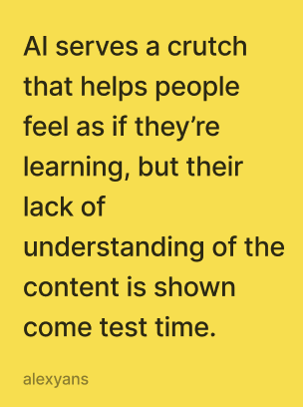
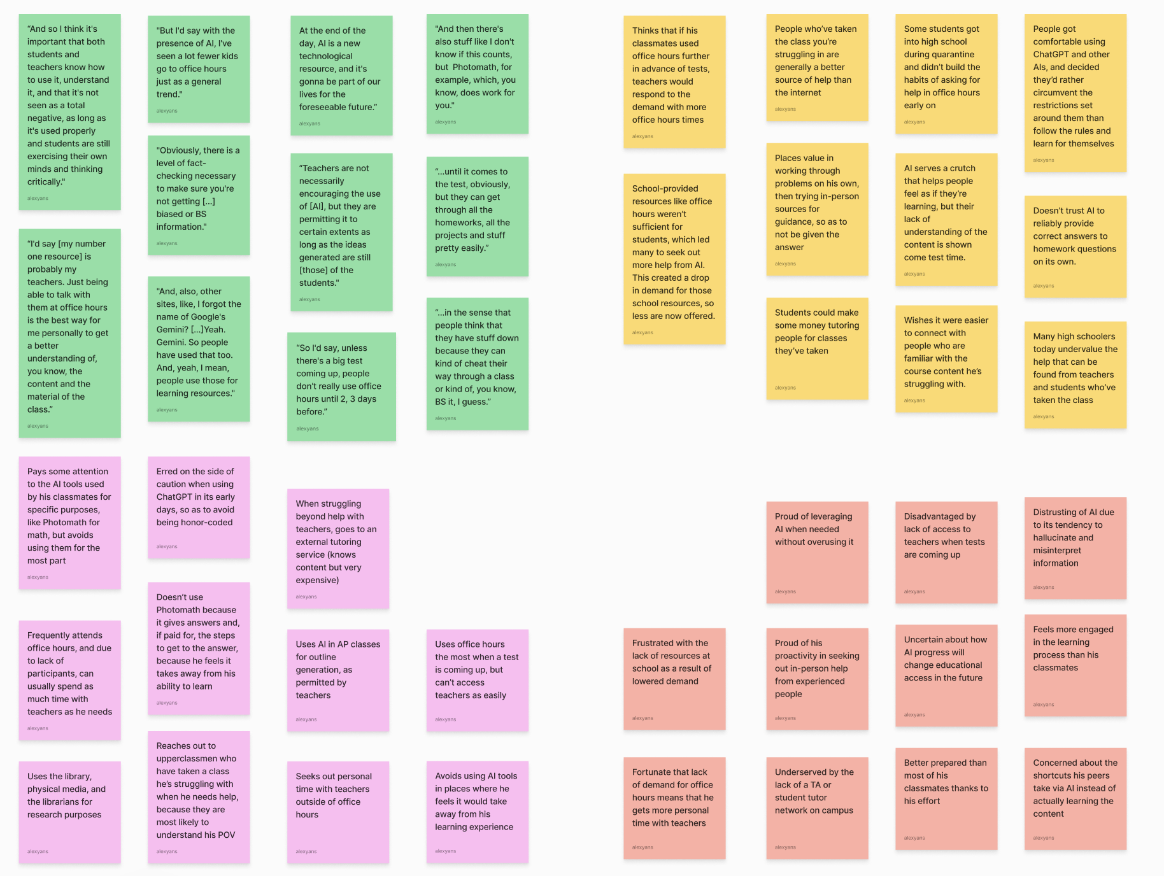
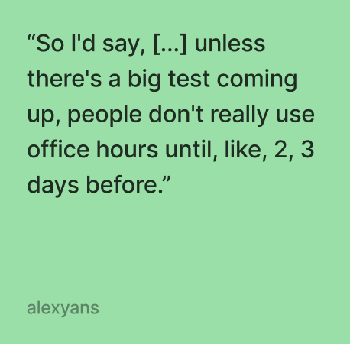
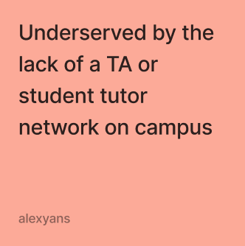
SAYS
THINKS
🕵️‍♂️
DOES
FEELS

Slide 21
“Alan Turing”
Insights:
Students are overly reliant on AI tools which are not a real replacement for TA or teacher help (using them as a crutch).
The lack of a network of TAs or student tutors restricts options for finding help.
Needs:
Improved communication channels between students, teachers, staff, etc.
Academic help from people with experience with the coursework when teachers are unavailable
🕵️‍♂️

Slide 22
Extreme Users
Ada Lovelace
(TA & EdTech Researcher)
Margaret Hamilton
(Student-Athlete + Pre-Med)

Slide 23
What we learned
Students feel that the lack of quality TAs and over-generalization of TA expertise makes getting help unappealing and not worthwhile.
Students prefer to work with and learn from other students who have experience in the coursework and can openly discuss course content.
There is a lack of office hour flexibility to satisfy the time demands, schedule, and quantity of students that are in need of personalized academic support.
The TA recruiting process is overly tedious while also lacking proper training on the job, leading to low-impact TAs while also excluding a large group of potential candidates.

Slide 24





Next Steps
More Interviews
Narrowing Down
Collect more data on the same subject from a broader range of people (teachers, professors, etc.)
Specify Problem Domain within Education Technology (video tutorials, study tools, tutoring, AI-powered tools)
Explore Innovation Potential
Combine to Create a Point of View
Find Patterns and Inconsistencies Across Findings + Needs
Explore new solutions and technologies to address unmet needs and challenge current systems & & HMWs

Slide 25
Thank you!

